Slide 1
Introduction to R Workshop
Amrom Obstfeld MD PhD
Notes:
Hello everyone and welcome to this years Introducton to R workshop. I am Amrom Obstfeld the organizer of the course representing the presenters. We are so excited you have made the decision to take the time to join us and learn about R and how it can be used to power reproducible high quality data analysis and data science.
This workshop is designed for beginners who are brand new to R and new to coding in general. If you have some experience we're here to help you build up some R muscle memory, in addition to completely newbs we often see those looking for a refresher come back to take the workshop again, so welcome all.

Slide 2
Course Introduction
Notes:
I'm here just to give you a quick introduction after which we'll dive right into the meat of the workshop.

Slide 3
Goals and Objectives
Advocate for the use of R as a means of improving reproducibility in clinical data analysis
Demonstrate how R is used to perform analyses of laboratory operational data
Establish a basis of understanding in the 'tidy' approach to data analysis within the framework of R
Notes:
Obviously we would love for those who are here today to all walk away and just start coding but the reality is that while that would be great we also have a set of more modest if more important goals
We're here to Advocate for the use of R as a means of improving reproducibility in clinical data analysis and I cannot emphasize enough how strongly we feel about this point
As we review this we will demonstrate how we can use R perform analyses of laboratory operational data
And we also hope to establish a baseline understanding of what tidy data is and how to implement a 'tidy' approach to data analysis within the framework of R

Slide 4
Session | Instructor
Introduction | Amrom Obstfeld
Introduction to R and RStudio | Joe Rudolf
Data Transformation | Amrom Obstfeld
Data Visualization | Sarah Dudgeon
Dashboards | Patrick Mathias

Slide 5
Who are we?

Slide 6
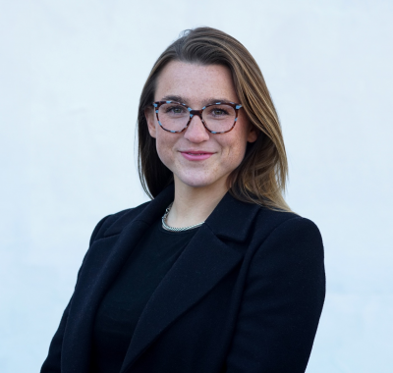
Sarah Dudgeon

Slide 7
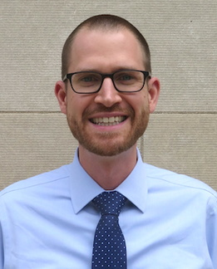
Joseph Rudolf
Assistant Professor, Department of Pathology, University of Utah Medical School
Medical Director, Automated Core Laboratory, ARUP Laboratories
Notes:
Joseph Rudolf, MD is the medical director for the automated core laboratory at ARUP Laboratories in Salt Lake City, Utah. His clinical and research interests focus on the intersection of informatics and clinical operations including clinical decision support, utilization management, and reporting and analytics. He is also passionate about clinical process improvement and initiatives to support quality and safety.

Slide 8
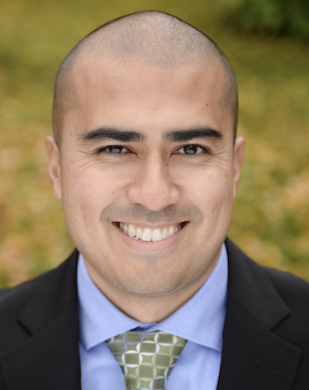
Patrick Mathias
Assistant Professor, Department of Laboratory Medicine and Pathology
University of Washington School of Medicine
Associate Medical Director, Laboratory Medicine and Pathology Informatics
Notes:
Patrick Mathias, MD, PhD, is the Associate Medical Director of the Informatics Division in the Department of Laboratory Medicine at the University of Washington School of Medicine. His interests include developing data science and analytics as a core competency to improve clinical lab operations and laboratory stewardship, and applying clinical informatics approaches to mitigate laboratory-associated diagnostic errors. He is interested in developing and improving programming and data science education across all levels of pathology practice.

Slide 9
Amrom Obstfeld
Assistant Professor of Clinical Pathology and Laboratory Medicine
University of Pennsylvania Perelman School of Medicine
Director of Pathology Informatics
Children's Hospital of Philadelphia
Notes:
And this is me, Amrom Obstfeld MD, PhD, I am the Medical Director of the Division of Pathology Informatics at Children’s Hospital of Philadelphia. In this role I lead the development of analytic tools to aid in quality management and operations, interfaces with other groups throughout the hospital on informatics initiatives and I also in design and implement informatics educational experiences for pathology trainees and faculty at the University of Pennsylvania.

Slide 10
Workshop Workflow
Notes:
So now that you've met us let's discuss for a moment how this workshop is going to work

Slide 11
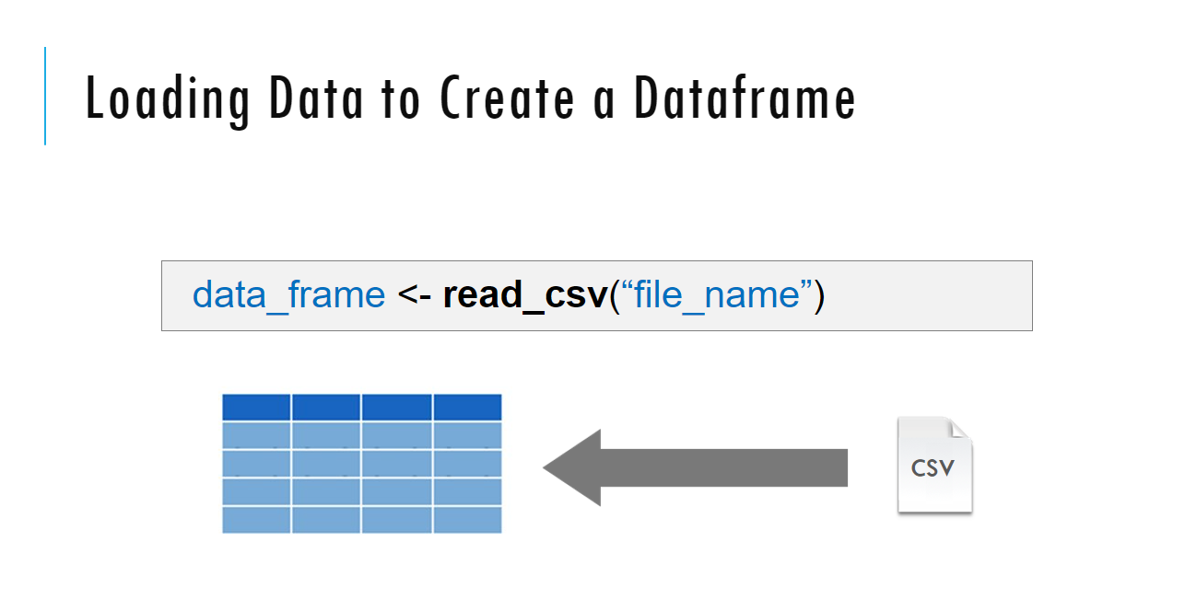
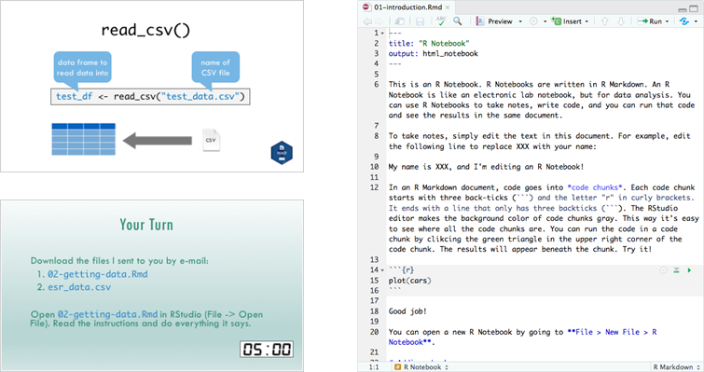
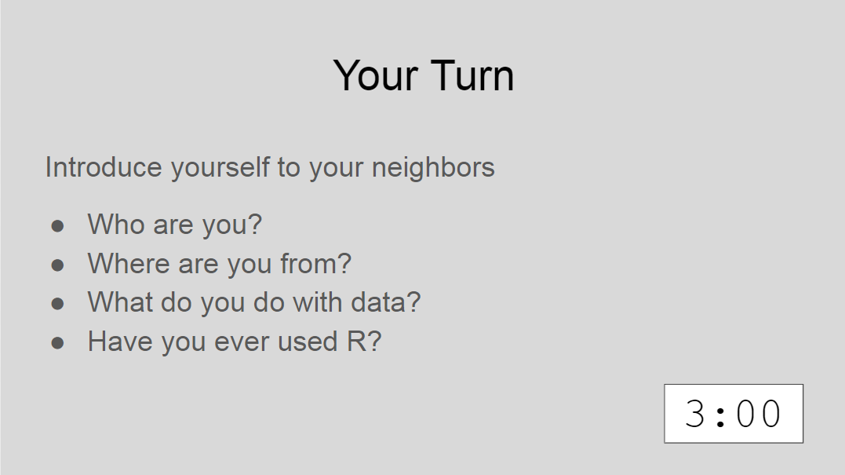
Sessions
Notes:
The meat of the workshop are the sessions each of which will cover discrete subjects or components of R in a data analysis. The sessions have a powerpoint associated with it as well as an R script.
We'll be describing a specific function or topic in the context of the powerpoint – all of which are included in the coursebook and available for download. The same code that is being demoed is included in the R script and you are invited to follow along, run the code, play with it if you like.
At several points in the session we'll have you engage in some exercises which we call Your Turns. In a Your Turn we'll assess how we're doing by asking you to critically think about the topic in the session and respond to a question or do some coding on your own. We'll speak a bit later about how these coding exercises will work.

Slide 12
Your Turns
Too Hard?
Ask a TA
If you're not done
Don’ t worry
Exercises will be reviewed
Fill in along with Presenter
All answers are in the files in the answer folder
Too Easy?
Play!
Modify the code – see what happens

Slide 13
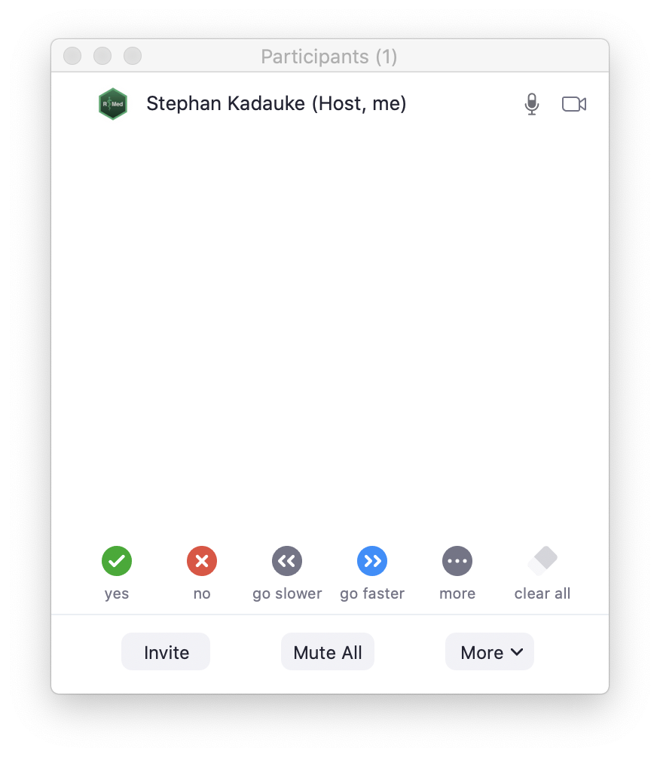

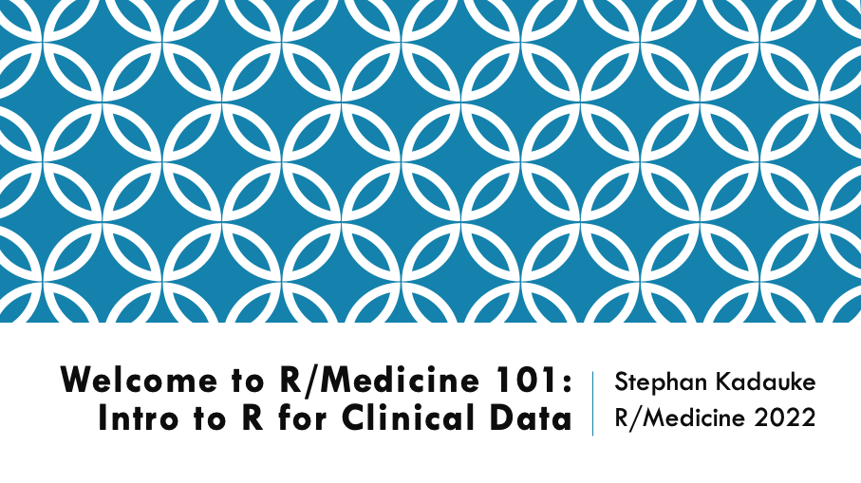
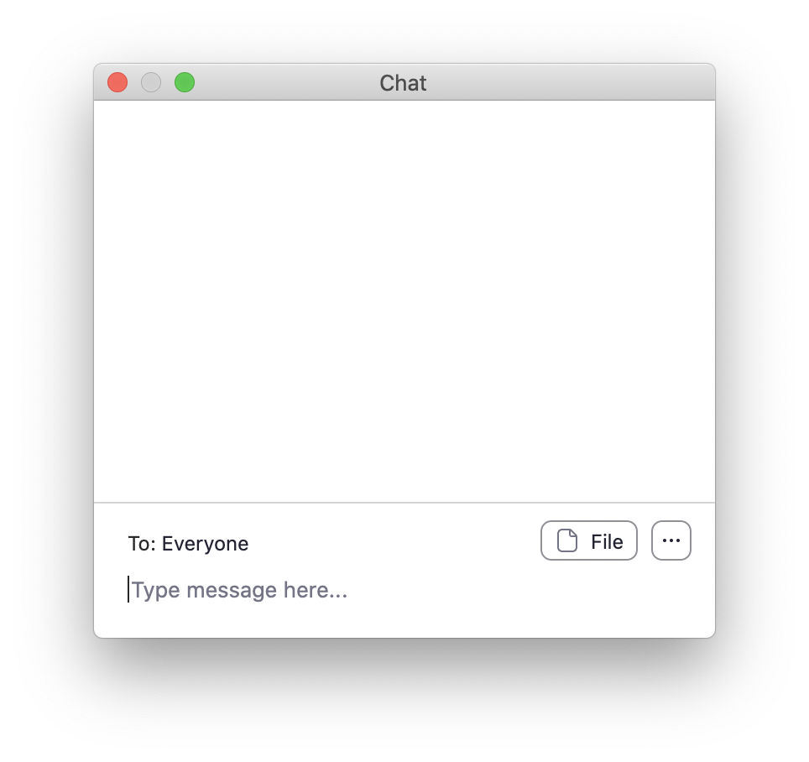
Notes:
This is the main Zoom window. On the bottom you should be able to see two buttons - Participants and Chat.
Click on these buttons now to open the Participants and Chat window, and place those windows somewhere you can see, if necessary by making your main Zoom window a little smaller.
**
**

Slide 14
Non-verbal feedback
Notes:
[skip if not enabled] We will make heavy use of the Non-verbal feedback functionality of Zoom. At various points, I will ask you to click "Yes" to let me know I can keep going. What I mean by that is to click the green circle with the check mark in the Participants window.

Slide 15
Chat window
Notes:
We will use the Chat window as the primary communication tool, primarily to get help if you get stuck with a technical issue. Please note that the presenter can't present and monitor the chat at the same time, so please don't send me private messages. Instead, post to Everyone, briefly describing the problem you have, and you will be helped by one of our TAs.
I also want to set expectations for help here. We have more than 100 participants today, and so please only ask for help if you need technical assistance with Zoom or the training environment. If you have a question about the material, we encourage you to write it down and ask during the breaks, or after the workshop.

Slide 16
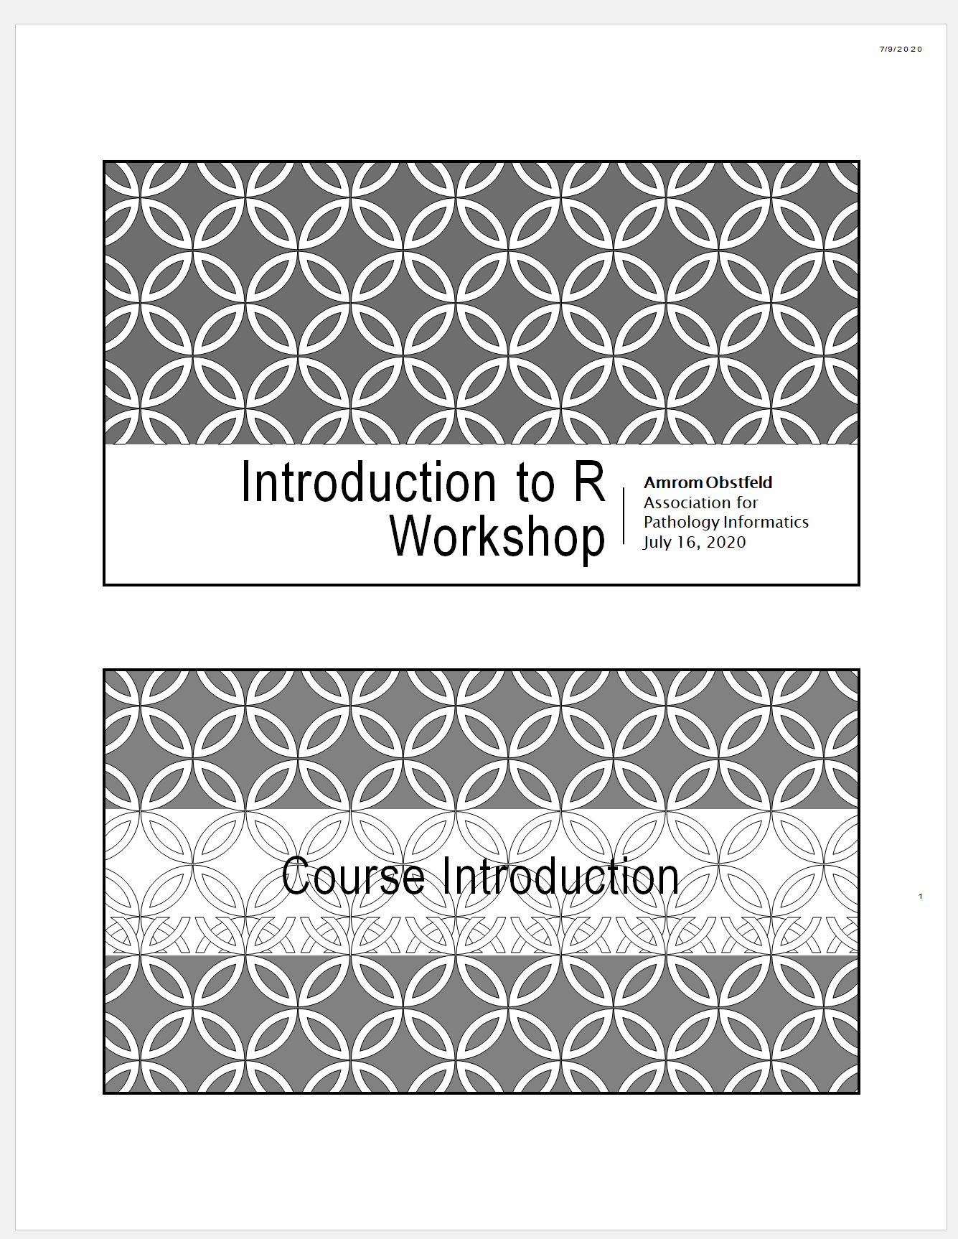
Workshop Coursebook
Print out of all slides
Appendix
Cheat sheets
Useful resources
Notes:
The coursebook has all the session powerpoints as well as an appendix that has some additional resources
Cheat sheets are concise one or two page documents that you can use as a quick reference. we'll be referring to these during the sessions. They are also easily googlable and available through the help menu in Rstudio. There is also a one page Useful resources document with links to free online resources like textbooks, videos and courses.

Slide 17
Your Turn #1
Click the “yes” button in the Participants window.
Then write your location (city, country) in the Chat window.
Notes:
This brings us to the first interactive exercise!
...

Slide 18
Who are you?
Notes:
So, now that you've learned a bit about us and how this is all going to work, let's find out a little bit about you

Slide 19

Your Turn
Introduce yourself to your breakout roommates
Who are you?
Where are you from?
Why are you here?
Have you ever used R?
Notes:
Assess how to do this…
For our first Your Turn Nova will send us all into breakout rooms. You may need to manually click the join break out room button. Once you're there feel free to share who you are, where you are in training or what your position is in your organization, and what you hope to get out of this course.
After a few minutes Nova will call us back together and we'll finish up this intro session.

Slide 20
Final Tips
The best way to learn to code is by doing!
Google is your friend
Notes:
And just some final words before we begin, no matter what you're learning but particularly coding, the best way to learn is by doing:
Find a project, make a goal for yourself, push yourself to use R, it's OK to lean on some excel, we all do when we're starting out, but try to get that activation energy to get your hands typing code. We would not be teaching this course if we didn't strongly believe that R is accessible to all of you. So keep practicing and you'll get there.
With that let's get started with the workshop. Up next Joe will provide us with the basics of R and get us up and running with Rstudio Cloud.

